Slide 1
The cardiac cycle and pressure changes
O Level Biology
M Shah

Slide 2
Today’s lesson
Topic covered: Transport in Humans
Syllabus requirement:
(d)describe the structure and function of the heart in terms of muscular contraction and the working of the valves

Slide 3
Mammals have a closed circulatory system that allows pressure to be maintained and regulated

Slide 4
Double circulation

Slide 5
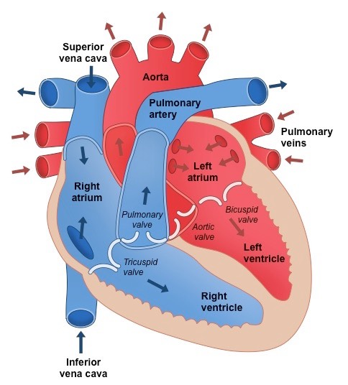
Structure of the heart

Slide 6
The valves

Slide 7
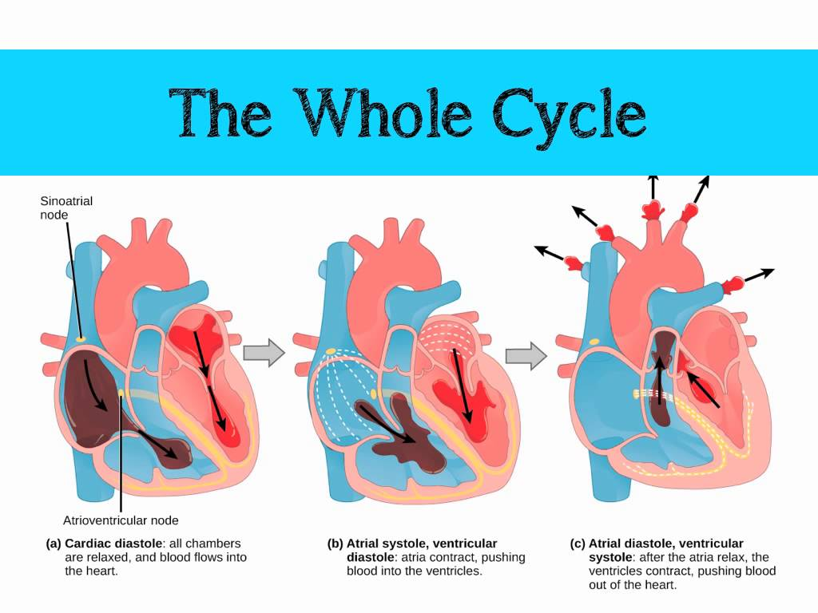

Slide 8
Pressure Changes in the Heart (Right)
ventricular systole
ventricular diastole
Pressure / mm of mercury
pressure in ventricle
pressure in aorta
atrial diastole
atrial systole
pressure in atrium
Time/s

Slide 9
Pressure Changes in the Heart (Left)
ventricular systole
ventricular diastole
Pressure / mm of mercury
pressure in aorta
pressure in ventricle
atrial diastole
atrial systole
pressure in atrium
Time/s

Slide 10
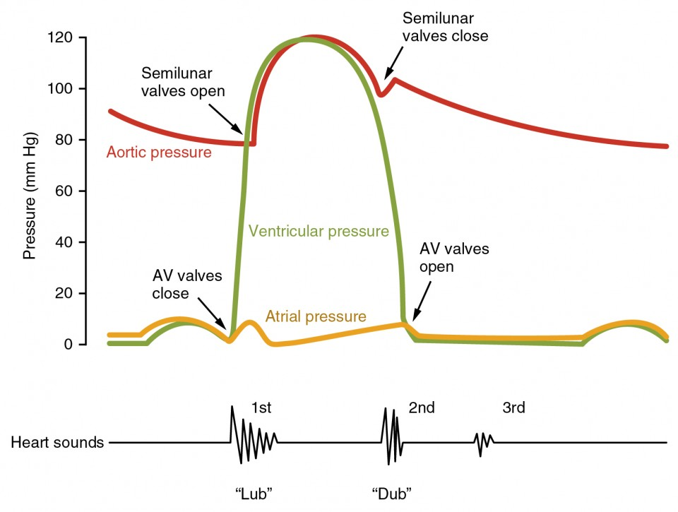
Cardiac cycle with heart sounds

Slide 11
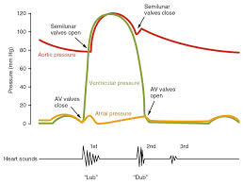
Left atrium
Contract
Left ventricle
Relax
Aortic pressure rises when the ventricles contract as blood is forced into the aorta
It then gradually falls but never below ~12 kPa because of the elasticity of its wall
which creates a recoil action – this is necessary if blood is to be continuously supplied
to the tissue
The recoil produces a temporary rise in pressure at the start of the relaxation phase

Slide 12
Left atrium
Contract
Left ventricle
Relax
Ventricluar pressure is low at first but gradually increases as the ventricles fill with
blood as the atria contract
The left atrioventricular valves close and pressure rises dramatically as the thick muscular
Walls of the ventricle contract
As pressure rises above that of the aorta, blood is forced into the aorta past the
semilunar valves
Pressure falls as the ventricles empty and the walls relax

Slide 13
Left atrium
Contract
Left ventricle
Relax
Atrial pressure is always relatively low because the thin walls of the atrium cannot
create much force
It is highest when they are contracting, but drops when the left atrioventricular valve
closes and its walls relax
The atria then fill with blood, which leads to a gradual build-up of pressure until a slight drop
when the left atrioventricular valve opens and some blood moves into the ventricle

Slide 14
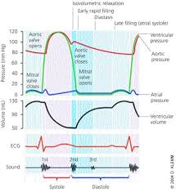
Left atrium
Relax
Left ventricle
Contract
Ventricular volume rises as the atria contract and the ventricles fill with blood
The volume then drops suddenly as blood is forced out into the aorta when
the semilunar valve opens
Volume increases again as the ventricles fill with blood

Slide 15
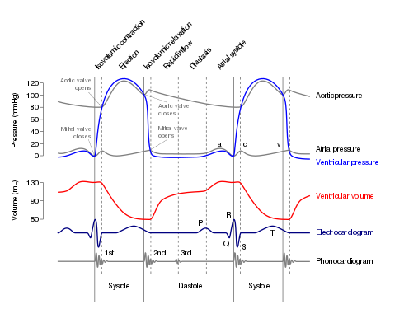

Slide 16
Useful Video links
Khan Academy : https://youtu.be/XTF0-54yJMk
Mr Pollock Biology: https://www.youtube.com/watch?v=p8Jj-n5KdjM

